Slide 1

SUICIDE PREDICTION USING REGRESSION AND CLASSIFICATION MODELS
Submitted by
Avhishek Biswas, Roll No. – 18700316065, Year – 2019, Dept. - ECE
Deep Bhattacharya, Roll No. – 18700316058, Year – 2019, Dept. - ECE
Ananya Talukdar, Roll No. – 18700316081, Year – 2019, Dept. - ECE
Arijit Chowdhury, Roll No. – 18700316070, Year – 2019, Dept. - ECE

Slide 2

AIM AND OBJECTIVE
In this project we are creating prediction and classification models using different machine learning methods.
Linear Regression
Naïve Bayes Classification
The data set is being used from Kaggle.com that has been produced by the Govt. Of India.
The prediction models will be predicting the number of deaths that occurred during the year 2011 and 2012.

Slide 3
DATASETS
YEAR | CATEGORY | TOTAL-DEATHS | PROBABILITY
2011 | No Education | 160880 | 0.396039604
2011 | Primary | 62341 | 0.153465347
2011 | Middle | 42231 | 0.103960396
2011 | Matriculate/Secondary | 36198 | 0.089108911
2011 | Hr. Secondary | 28154 | 0.069306931
2011 | Diploma | 38209 | 0.094059406
2011 | Graduate | 22121 | 0.054455446
2011 | Post-Grad or above | 16088 | 0.03960396
Education Categories
YEAR | CATEGORY | TOTAL-DEATHS | PROBABILITY
2011 | Never Married | 91989 | 0.226153336
2011 | Married | 285045 | 0.70077811
2011 | Separated | 11112 | 0.027318656
2011 | Divorcee | 3849 | 0.009462699
2011 | Widowed/Widower | 14760 | 0.0362872
YEAR | CATEGORY | TOTAL-DEATHS | PROBABILITY
2011 | Unemployed | 43568 | 0.323159199
2011 | Farming/Agriculture | 14027 | 0.104043199
2011 | Government Service | 4310 | 0.031968788
2011 | Private Sector | 11172 | 0.082866658
2011 | Self-Employed or Other Activity | 61742 | 0.457962157
Social Categories
Professional Categories

Slide 4

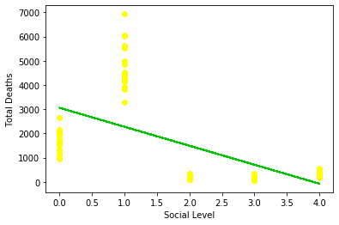
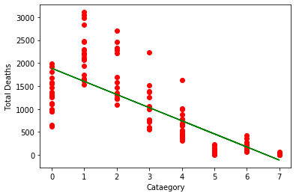
LINEAR REGRESSION
Initially we are using linear regression.
Educational Level vs Total Deaths and Social Level vs Total Deaths

Slide 5

NAIVE BAYES
What is Naive Bayes?
Naive Bayes is a simple technique for constructing classifiers: models that assign class labels to problem instances, represented as vectors of feature values, where the class labels are drawn from some finite set.
What is Naive Bayes used for?
Naive Bayes uses a similar method to predict the probability of different class based on various attributes. This algorithm is mostly used in text classification and with problems having multiple classes.

Slide 6

TRAINING DATASET
ANALYSIS

Slide 10
TESTING RESULTS

Slide 14
CONCLUSION
The proposed method shows a high degree of accuracy in predicting the number of suicides.
The method allows for identification of the sub-categories of persons who are highly at risk of committing suicide.
The model can be improved in future through incorporation of classification algorithms such as SVMs and Convolutional Neural Networks.

Slide 15
REFERENCES
Berk, Richard A. (2007). "Regression Analysis: A Constructive Critique". Criminal Justice Review. 32 (3): 301–302. doi:10.1177/0734016807304871.
Rish, Irina. "An empirical study of the naive Bayes classifier." IJCAI 2001 workshop on empirical methods in artificial intelligence. Vol. 3. No. 22. 2001.
Rennie JD, Shih L, Teevan J, Karger DR. Tackling the poor assumptions of naive bayes text classifiers. InProceedings of the 20th international conference on machine learning (ICML-03) 2003 (pp. 616-623).
L. Jiang, H. Zhang and Z. Cai, "A Novel Bayes Model: Hidden Naive Bayes," in IEEE Transactions on Knowledge and Data Engineering, vol. 21, no. 10, pp. 1361-1371, Oct. 2009, doi: 10.1109/TKDE.2008.234.
Warne, Russell T. (2011). "Beyond multiple regression: Using commonality analysis to better understand R2 results". Gifted Child Quarterly. 55 (4): 313–318. doi:10.1177/0016986211422217.
Lange, Kenneth L.; Little, Roderick J. A.; Taylor, Jeremy M. G. (1989). "Robust Statistical Modeling Using the Distribution" (PDF). Journal of the American Statistical Association. 84 (408): 881–896. doi:10.2307/2290063. JSTOR 2290063.
Russell, Stuart; Norvig, Peter (2003) [1995]. Artificial Intelligence: A Modern Approach(2nd ed.). Prentice Hall. ISBN 978-0137903955.
Hand, D. J.; Yu, K. (2001). "Idiot's Bayes — not so stupid after all?". International Statistical Review. 69 (3): 385–399. doi:10.2307/1403452. ISSN 0306-7734. JSTOR 1403452.
Zhang, Harry. The Optimality of Naive Bayes (PDF). FLAIRS2004 conference.
Caruana, R.; Niculescu-Mizil, A. (2006). An empirical comparison of supervised learning algorithms. Proc. 23rd International Conference on Machine Learning. CiteSeerX 10.1.1.122.5901.

Slide 16

THANK YOU

